Slide 1
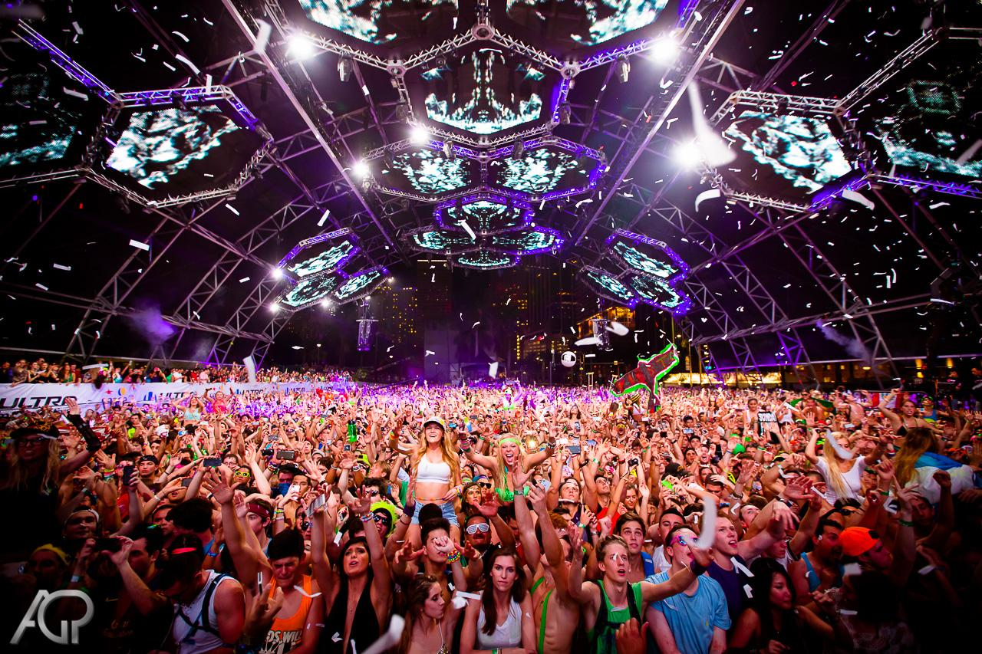
Music Festival Classification
John Gilling
Metis Data Science

Slide 2
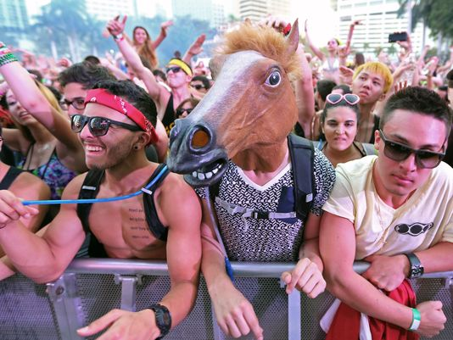
Background
Music Festivals in the U.S. are:
Growing rapidly in size and in number -- 32 million attendees in 2014 alone! (WSJ, July 1, 2015)
Crucial for the reputation of musical artists in a changing market.
Important venues for cultural exchange between people (read: millenials).

Slide 3
BUT HOW DO YOU KNOW IN ADVANCE WHO WILL BE PERFORMING?!?

Slide 4
Classification Problem
Dataset:
- Collection of 2060 festival artists from 2010 - 2014.
- Ten major music festivals (see next slide).
Classification:
Given a particular artist, did they or didn’t they perform at each one of these ten festivals in 2015?

Slide 5
Data
Sources:
The Echo Nest API for genre tags and artist familiarity/hotttnesss.
SongKick for artist touring history and festival lineups.
Spotify API for genre grouping.

Slide 6
Classification Models
Imbalanced class sizes (i.e. not all 2060 artists will go to a single festival).
Sparse data (genre categories and previous festival appearances).
Class-Weighted Support Vector Machine model for binary classification.
A new model (i.e. different parameters and features) was trained for each of the festivals, for a total of ten different models.

Slide 7
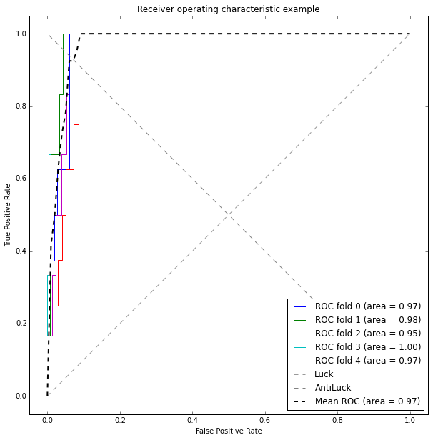
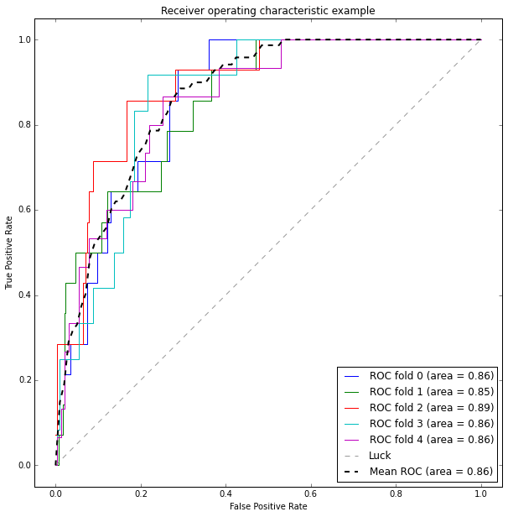
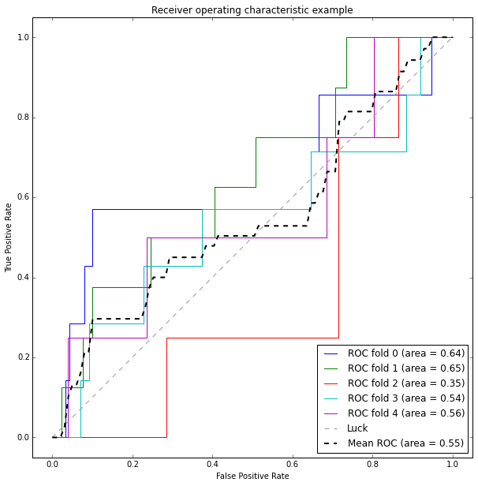
Results
From the good ...
(South by Southwest 2015)
… to the moderate ...
(Beale Street 2015)
(Bonnaroo 2015)
Test Precision: 100%
Test Recall: 30%
Test Precision: 33%
Test Recall: 16%
Test Precision: 0%
Test Recall: 0%
… to the “couldn’t get much worse.”
Note: due to the unequal class sizes, I attempted to maximize precision and recall rather than accuracy.

Slide 8

BONUS VISUALIZATION TIME!!!
WHO WENT WHERE IN 2015?

